Slide 1
CSC 355 Database Systems
Lecture 1
Eric J. Schwabe
School of Computing, DePaul University
Spring 2020

Slide 2
Topics:
Course Organization
Introduction to Databases
SQLDeveloper

Slide 3
Contact Information
Course web site: http://d2l.depaul.edu/
  Weekly discussion forum for questions/comments
Office hours: Monday and Wednesday 1:00pm-2:00pm, and Wednesday 3:00pm-4:00pm
  Via Zoom at https://depaul.zoom.us/my/eschwabe
Email: eschwabe@depaul.edu
  Please begin subject line with “CSC 355” and sign your name
  Expect reply within one business day

Slide 4
Course Texts
Required text:
A First Course in Database Systems (third edition), Ullman and Widom
(ISBN 978-0136006374)
Additional reference (optional):
Murach’s Oracle SQL and PL/SQL for Developers (second edition), Murach (ISBN 978-1890774806)

Slide 5
Course Policies
Grading: 30% homework, 30% midterm exam, 30% final exam, 10% quizzes
  HWs accepted late (up to 24 hours only) with penalty
  Lowest HW score will be dropped
  Submit HWs through d2l, no emailed submissions
  Exam will be given through d2l, details TBA
Course prerequisite: CSC 301 or CSC 393
University policies: See posted syllabus
Weekly schedule: See posted document

Slide 6
Academic Integrity Policy
http://academicintegrity.depaul.edu/
  Cheating: Any action that violates university norms or instructor guidelines for course work
  Plagiarism: Any use of another’s work without proper citation where original work is expected
  Complicity: Any action that facilitates an academic integrity violation

Slide 7
Databases are Everywhere
Amazon (or any online store…)
Southwest (or any airline…)
Chase (or any bank…)
Campusconnect (or any university system…)
…and those are just a few…you are interacting with databases every day…

Slide 8
What is a database?
Data is information that can be recorded and has a known meaning
A database is an organized collection of logically related data that are typically…
  Persistent: are stored on a stable medium
  Shared: have multiple uses and interested users
  Interrelated: form a bigger picture

Slide 9
Why Use a Database System?
Early data processing systems used files of data in plain text form
Problem: program-data dependence led to
  limited data sharing
  duplication of data
  increased time for development and maintenance

Slide 10
Why Use a Database System?
A database uses a single repository of data accessed by multiple users
  Contains information on the structure of the data
  Allows sharing of and concurrent access to data
  Supports different views of the data
The costs are higher overhead for the design, implementation, and maintenance of the data
What are the benefits?

Slide 11
Benefits of Database Systems
Program-data independence
Controlled data redundancy
Controlled access to data
Support for multiple user interfaces
More efficient query processing
Faster application development

Slide 12
Database Management Systems
A database management system (DBMS) is a collection of software components that lets you
  create (e.g., define, construct)
  maintain (e.g., modify, keep available)
  control access to (e.g., secure, allow queries to)
a database

Slide 13
Database Management Systems
DBMS Examples: Oracle, IBM DB2, MS Access/SQL Server, MySQL
We can work with a DBMS directly or through an application that supplies a particular interface (e.g., SQLDeveloper)
The database and DBMS together make up a database system

Slide 14
Database Models
Older Models:
  File Systems, Hierarchical, Network
  All had drawbacks…
The Relational Model
Newer Models:
  Semi-structured, Object-relational, NoSQL
  …not as popular as Relational Model

Slide 15
File Systems
Data stored in simple text files, each one possibly having a different fixed organization of its data
High level of program-data dependence
Difficult to share data
Not practical to optimize queries

Slide 16
Hierarchical/Network Models
Hierarchical Model: Data arranged in “parent-child” relationships
Network Model: Can represent more general relationships among types of data
Both models have similar weaknesses:
  Applications must navigate relationships explicitly
  DBMS can not rearrange data to optimize queries

Slide 17
Relational Model
First model to separate the logical structure of the database from its physical implementation
Data are divided into two-dimensional tables called relations
Tables are linked by shared columns of data
Rules exist for dividing data among tables
A standardized query language exists (SQL)

Slide 18
Newer Models
Semi-structured databases: Store collections of data in XML files
Object-relational databases: Add support for structured data types to relational databases
Document databases: Have a less restrictive structure, typically without a fixed schema
Data warehouses: Integrate multiple sources of data, possibly from different models

Slide 19
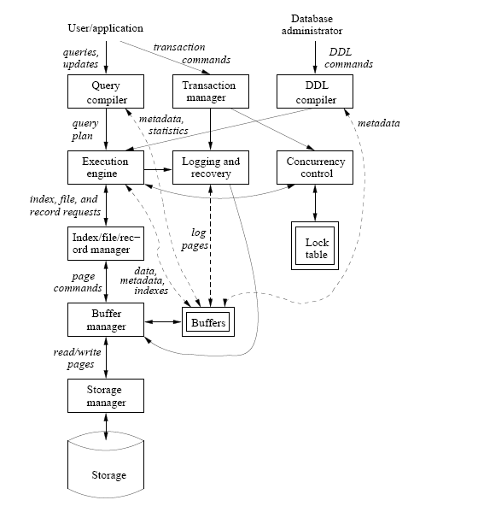
Components of a DBMS
(From Ullman/Widom)

Slide 20
User Interactions with DBMS
Database Definition: Create database schema, links between tables, constraints
Query Processing: Request retrieval or modification of data (“queries”/“actions”)
Transaction Processing: Execute sets of operations that must be executed as a unit (“transactions”)

Slide 21
Approximate Course Schedule
Week 1: Introduction and Relational Model
Weeks 2-5: SQL DDL, Queries, Transactions
Weeks 6-7: Relational Database Design
Weeks 8-9: Constraints and Triggers, Database Programming, Views
Week 10: Slack Time / Course Review

Slide 22
SQLDeveloper
SQLDeveloper is an application that works as a “front-end” connection to a server running an Oracle DBMS (e.g., Oracle 12c)
SQL commands can be run individually, or collected in script files.
Can be downloaded free from Oracle

Slide 23
Setting Up a Connection
To set up a new connection to acadoradbprd01:
  Connection Name: YOURNAME355
  Username: your campusconnect username
  Password: cdm####### (initially uses your 7-digit Student ID)
  Hostname: acadoradbprd01.dpu.depaul.edu
  Port: 1521
  SID: ACADPRD0
  Test, then Connect…
Double-click to Open an existing connection
Disconnect (and commit) when you’re done!

Slide 24
Running SQL Commands
Single SQL command:
  Type command, then Execute (Ctrl-Enter)
    e.g, to change password, ALTER USER username IDENTIFIED BY newpassword ;
Script (SQL commands stored in a file):
  Type @ followed by full path to script file, then Run Script (F5)
Output will appear in bottom window under
Query Result or Script Output

Slide 25
Browsing Database Tables
Left window shows current Tables, click on
+ to expand list
Right-click on Tables and choose Refresh to see changes (can also Commit changes)
Click on a table to view it in the center window (may need to Refresh view also)
  COLUMNS shows schema
  DATA shows contents

Slide 26
Saving SQLDeveloper Output
Three ways:
  Click on Save icon to save contents of Script Output window to a file
  Highlight and then copy and paste contents of Script Output window to a file
  Take and save screenshot of SQLDeveloper display

Slide 27
Next:
The Relational Model

